Slide 1
Military Techincal Academy
Principles of Programming Language
Brief History

Slide 2
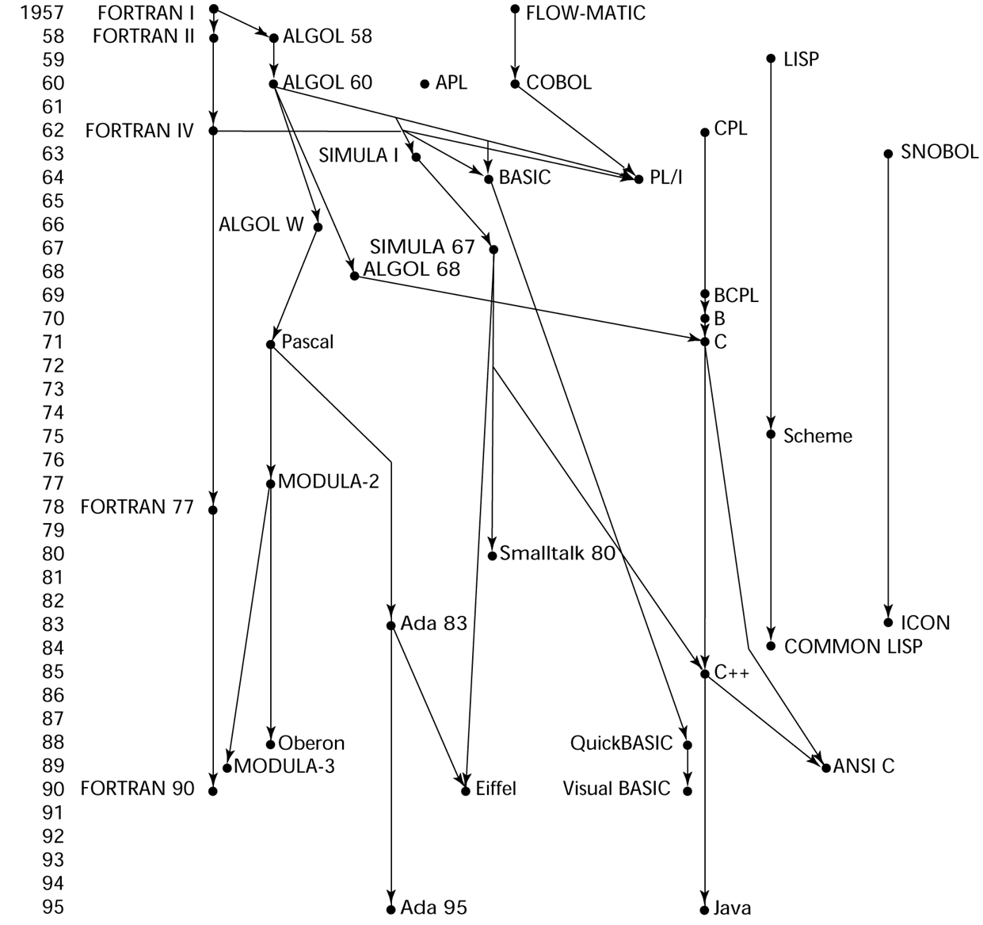
Brief History

Slide 3
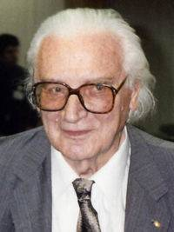
Zuse’s Plankalkül
First “high-level” language
Designed in 1945, but not published until 1972
Never implemented
Advanced data structures
  floating point, arrays, records
Konrad Zuse
http://en.wikipedia.org/wiki/Konrad_Zuse

Slide 4
Plankalkül Syntax
An assignment statement to assign the expression A[4] + 1 to A[5]
| A + 1 => A
V | 4 5 (subscripts)
S | 1.n 1.n (data types)

Slide 5
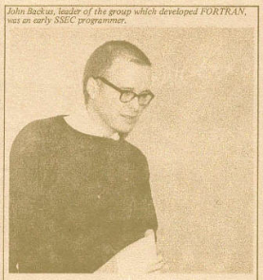
FORTRAN
Fortran 0: 1954 - not implemented
Fortran I:1957
  Designed for the new IBM 704, which had index registers and floating point hardware
  - This led to the idea of compiled programming languages, because there was no place to hide the cost of interpretation (no floating-point software)
  Environment of development
    Computers were small and unreliable
    Applications were scientific
    No programming methodology or tools
    Machine efficiency was the most important concern
http://en.wikipedia.org/wiki/Fortran
John Backus

Slide 6
Design Process of Fortran
Impact of environment on design of Fortran I
  No need for dynamic storage
  Need good array handling and counting loops
  No string handling, decimal arithmetic, or powerful input/output (for business software)

Slide 7
Fortran I Overview
First implemented version of Fortran
  Names could have up to six characters
  Post-test counting loop (DO)
  Formatted I/O
  User-defined subprograms
  Three-way selection statement (arithmetic IF)
  No data typing statements

Slide 8
Fortran I Overview
First implemented version of FORTRAN
  No separate compilation
  Compiler released in April 1957, after 18 worker-years of effort
  Programs larger than 400 lines rarely compiled correctly, mainly due to poor reliability of 704
  Code was very fast
  Quickly became widely used

Slide 9
Fortran II
Distributed in 1958
  Independent compilation
  Fixed the bugs

Slide 10
Fortran IV
Evolved during 1960-62
  Explicit type declarations
  Logical selection statement
  Subprogram names could be parameters
  ANSI standard in 1966

Slide 11
Fortran 77
Became the new standard in 1978
  Character string handling
  Logical loop control statement
  IF-THEN-ELSE statement

Slide 12
Fortran 90
Most significant changes from Fortran 77
  Modules
  Dynamic arrays
  Pointers
  Recursion
  CASE statement
  Parameter type checking

Slide 13
Latest versions of Fortran
Fortran 95 – relatively minor additions, plus some deletions
Fortran 2003 - ditto

Slide 14
Fortran Evaluation
Highly optimizing compilers (all versions before 90)
  Types and storage of all variables are fixed before run time
Dramatically changed forever the way computers are used
Characterized as the lingua franca of the computing world

Slide 15
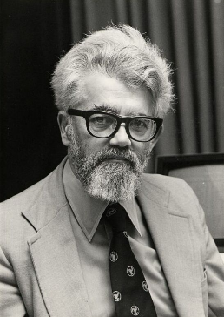
Functional Programming: LISP
LISt Processing language
  Designed at MIT by McCarthy
AI research needed a language to
  Process data in lists (rather than arrays)
  Symbolic computation (rather than numeric)
Only two data types: atoms and lists
Syntax is based on lambda calculus

Slide 16
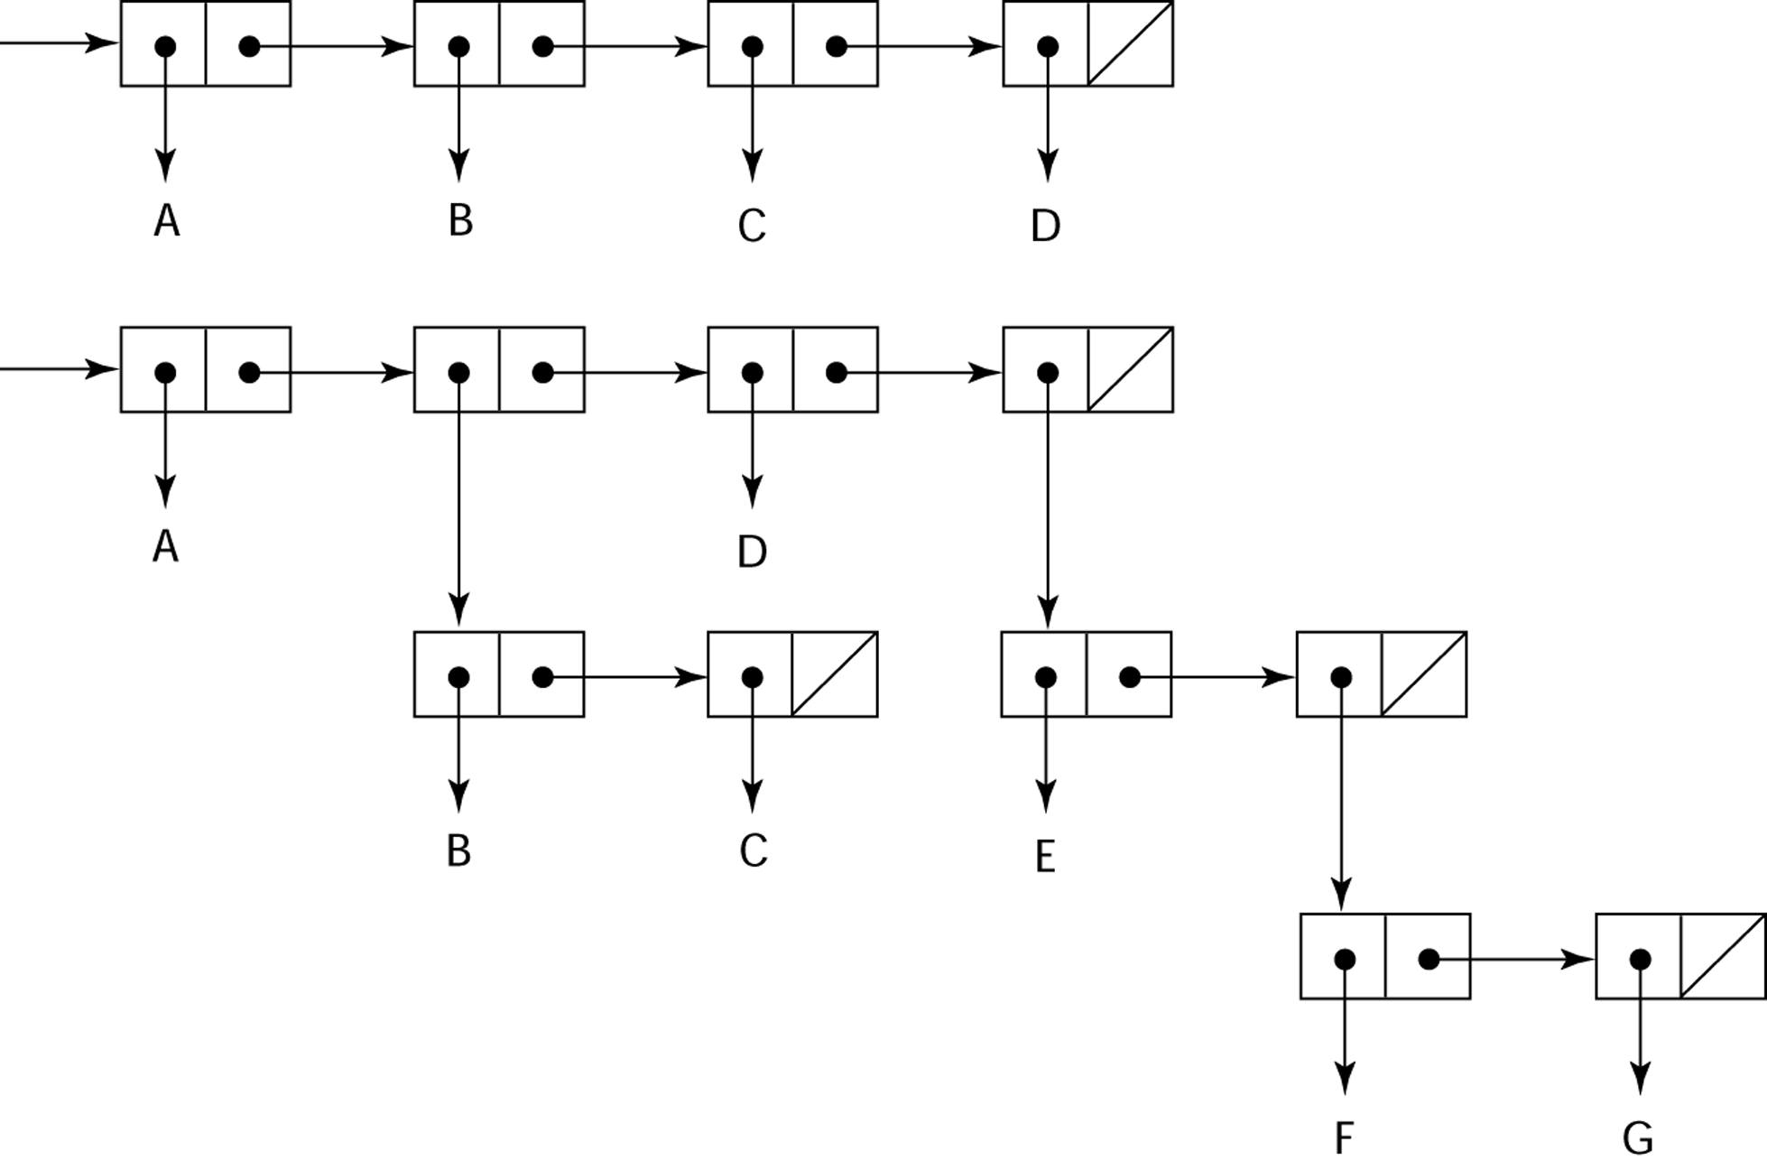
Representation of Two LISP Lists
Representing the lists (A B C D)
and (A (B C) D (E (F G)))

Slide 17
LISP Evaluation
Pioneered functional programming
  No need for variables or assignment
  Control via recursion and conditional expressions
Still the dominant language for AI
COMMON LISP and Scheme are contemporary dialects of LISP
ML, Miranda, and Haskell are related languages

Slide 18
The First Step Toward Sophistication: ALGOL 60
Environment of development
  FORTRAN had (barely) arrived for IBM 70x
  Many other languages were being developed, all for specific machines
  No portable language; all were machine- dependent
  No universal language for communicating algorithms
ALGOL 60 was the result of efforts to design a universal language

Slide 19
Early Design Process
ACM and GAMM met for four days for design (May 27 to June 1, 1958)
Goals of the language
  Close to mathematical notation
  Good for describing algorithms
  Must be translatable to machine code

Slide 20
ALGOL 58
Concept of type was formalized
Names could be any length
Arrays could have any number of subscripts
Parameters were separated by mode (in & out)
Subscripts were placed in brackets
Compound statements (begin ... end)
Semicolon as a statement separator
Assignment operator was :=
if had an else-if clause
No I/O - “would make it machine dependent”

Slide 21
ALGOL 58 Implementation
Not meant to be implemented, but variations of it were (MAD, JOVIAL)
Although IBM was initially enthusiastic, all support was dropped by mid 1959

Slide 22
ALGOL 60 Overview
Modified ALGOL 58 at 6-day meeting in Paris
New features
  Block structure (local scope)
  Two parameter passing methods
  Subprogram recursion
  Stack-dynamic arrays
  Still no I/O and no string handling

Slide 23
ALGOL 60 Evaluation
Successes
  It was the standard way to publish algorithms for over 20 years
  All subsequent imperative languages are based on it
  First machine-independent language
  First language whose syntax was formally defined (BNF)

Slide 24
ALGOL 60 Evaluation (continued)
Failure
  Never widely used, especially in U.S.
  Reasons
    Lack of I/O and the character set made programs non-portable
    Too flexible--hard to implement
    Entrenchment of Fortran
    Formal syntax description
    Lack of support from IBM

Slide 25
The Beginning of Timesharing: BASIC
Designed by Kemeny & Kurtz at Dartmouth
Design Goals:
  Easy to learn and use for non-science students
  Must be “pleasant and friendly”
  Fast turnaround for homework
  Free and private access
  User time is more important than computer time
Current popular dialect: Visual BASIC
First widely used language with time sharing

Slide 26
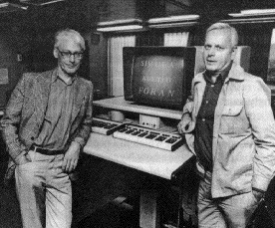
The Beginning of Data Abstraction: SIMULA 67
Designed primarily for system simulation in Norway by Nygaard and Dahl
Based on ALGOL 60 and SIMULA I
Primary Contributions
  Coroutines - a kind of subprogram
  Classes, objects, and inheritance
http://en.wikipedia.org/wiki/Simula

Slide 27
Orthogonal Design: ALGOL 68
From the continued development of ALGOL 60 but not a superset of that language
Source of several new ideas (even though the language itself never achieved widespread use)
Design is based on the concept of orthogonality
  A few basic concepts, plus a few combining mechanisms

Slide 28
ALGOL 68 Evaluation
Contributions
  User-defined data structures
  Reference types
  Dynamic arrays (called flex arrays)
Comments
  Less usage than ALGOL 60
  Had strong influence on subsequent languages, especially Pascal, C, and Ada

Slide 29
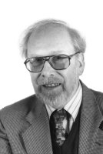
Pascal - 1971
Developed by Niklaus Wirth (a former member of the ALGOL 68 committee)
Designed for teaching structured programming
Small, simple, nothing really new
Largest impact was on teaching programming
  From mid-1970s until the late 1990s, it was the most widely used language for teaching programming

Slide 30
C - 1972
Designed for systems programming (at Bell Labs by Dennis Richie)
Evolved primarily from BCLP, B, but also ALGOL 68
Powerful set of operators, but poor type checking
Initially spread through UNIX
Many areas of application

Slide 31
Perl
Related to ALGOL only through C
A scripting language
  A script (file) contains instructions to be executed
  Other examples: sh, awk, tcl/tk
Developed by Larry Wall
Perl variables are statically typed and implicitly declared
  Three distinctive namespaces, denoted by the first character of a variable’s name
Powerful but somewhat dangerous
Widely used as a general purpose language and for CGI programming on the Web

Slide 32
Perl
Related to ALGOL only through C
A scripting language
  A script (file) contains instructions to be executed
  Other examples: sh, awk, tcl/tk
Developed by Larry Wall
Perl variables are statically typed and implicitly declared
  Three distinctive namespaces, denoted by the first character of a variable’s name
Powerful but somewhat dangerous
Widely used as a general purpose language and for CGI programming on the Web

Slide 33
Programming Based on Logic: Prolog
Developed, by Comerauer and Roussel (University of Aix-Marseille), with help from Kowalski ( University of Edinburgh)
Based on formal logic
Non-procedural
Can be summarized as being an intelligent database system that uses an inferencing process to infer the truth of given queries
Highly inefficient, small application areas

Slide 34
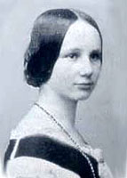
History’s Largest Design Effort: Ada
Huge design effort, involving hundreds of people, much money, and about eight years
  Strawman requirements (April 1975)
  Woodman requirements (August 1975)
  Tinman requirements (1976)
  Ironman equipments (1977)
  Steelman requirements (1978)
Named Ada after Augusta Ada Byron, the first programmer

Slide 35
Ada Evaluation
Contributions
  Packages - support for data abstraction
  Exception handling - elaborate
  Generic program units
  Concurrency - through the tasking model
Comments
  Competitive design
  Included all that was then known about software engineering and language design
  First compilers were very difficult; the first really usable compiler came nearly five years after the language design was completed

Slide 36
Ada 95
Ada 95 (began in 1988)
  Support for OOP through type derivation
  Better control mechanisms for shared data
  New concurrency features
  More flexible libraries
Popularity suffered because the DoD no longer requires its use but also because of popularity of C++

Slide 37
Object-Oriented Programming: Smalltalk
Developed at Xerox PARC, initially by Alan Kay, later by Adele Goldberg
First full implementation of an object-oriented language (data abstraction, inheritance, and dynamic binding)
Pioneered the graphical user interface design
Promoted OOP

Slide 38
Combining Imperative and Object-Oriented Programming: C++
Developed at Bell Labs by Stroustrup in 1980
Evolved from C and SIMULA 67
Facilities for object-oriented programming, taken partially from SIMULA 67
Provides exception handling
A large and complex language, in part because it supports both procedural and OO programming
Rapidly grew in popularity, along with OOP
ANSI standard approved in November 1997
Microsoft’s version (released with .NET in 2002): Managed C++
  delegates, interfaces, no multiple inheritance

Slide 39
An Imperative-Based Object-Oriented Language: Java
Developed at Sun in the early 1990s
  C and C++ were not satisfactory for embedded electronic devices
Based on C++
  Significantly simplified (does not include struct, union, enum, pointer arithmetic, and half of the assignment coercions of C++)
  Supports only OOP
  Has references, but not pointers
  Includes support for applets and a form of concurrency

Slide 40
Java Evaluation
Eliminated many unsafe features of C++
Supports concurrency
Libraries for applets, GUIs, database access
Portable: Java Virtual Machine concept, JIT compilers
Widely used for Web programming
Use increased faster than any previous language
Most recent version, 5.0, released in 2004

Slide 41
Scripting Languages for the Web
JavaScript
  Began at Netscape, but later became a joint venture of Netscape and Sun Microsystems
  A client-side HTML-embedded scripting language, often used to create dynamic HTML documents
  Purely interpreted
  Related to Java only through similar syntax
PHP
  PHP: Hypertext Preprocessor, designed by Rasmus Lerdorf
  A server-side HTML-embedded scripting language, often used for form processing and database access through the Web
  Purely interpreted
Python
  An OO interpreted scripting language
  Type checked but dynamically typed
  Used for CGI programming and form processing
  Dynamically typed, but type checked
  Supports lists, tuples, and hashes

Slide 42
A C-Based Language for the New Millennium: C#
Part of the .NET development platform (2000)
Based on C++ , Java, and Delphi
Provides a language for component-based software development
All .NET languages (C#, Visual BASIC.NET, Managed C++, J#.NET, and Jscript.NET) use Common Type System (CTS), which provides a common class library

Slide 43
Summary
Development, development environment, and evaluation of a number of important programming languages
Perspective into current issues in language design

